Slide 1
Build an Agentic Workflow
Notes:
# Build an Agentic Workflow — Content Guide
**Source:** `../AI Part 1 Lecture Content.md`, `../../overview.md`, `../../activities/L4.3a_Build_Agentic_Workflow/`, `../../activities/L4.3b_Agent_Reinforcement/`
**Audience:** CPT operators transitioning from manual effects operations into SI-assisted hunt and triage workflow construction.
**Duration:** ~60 minutes lecture + transition to hands-on build.
**Prerequisites:** Effects vocabulary, handoff discipline, tactical planning vocabulary, baseline threat-hunt triage, and the team DGX Spark (LiteLLM up; n8n enabled in this lab hour).
**References:**
- `../AI Part 1 Lecture Content.md` (legacy draft source)
- `../../overview.md`
- `../../activities/L4.3a_Build_Agentic_Workflow/L4.3a Student Guide.md`
- `../../activities/L4.3a_Build_Agentic_Workflow/L4.3a Instructor Setup Notes.md`
- `../../activities/L4.3b_Agent_Reinforcement/L4.3b Student Brief.md`
- `../../activities/L4.3b_Agent_Reinforcement/L4.3b Instructor Answer Key.md`
- `./4.4 Agent Tool Use and RAG Content Guide.md` (next lecture in sequence)
---
## Instructor resources and pre-class
- Classroom projector and screen; whiteboard for the opening contract
- Parent or sibling briefs listed in this Module folder
- Live tabs and references already named in this file's header
- Do not project flags, tokens, or answer-key values
## Student resources
- Student brief, student guide, or homework file in this Module folder when present
- Assigned range, workstation, or lab stack named in the student-facing file
- No extra kit beyond what the student-facing file already lists
## Dual opening
### Option 1 (Interactive / Whiteboard / Kinesthetic)
- **Say:** "This course shifts from manual effects operations into SI-assisted workflow construction. We are not treating the model as an authority. We are building a local workflow that reads evidence, applies a prompt, produces structured output, and tells us when a human needs to review the result."
- **Do:** Put the lesson contract on the board. Keep products from the prerequisite Module available.
- **Ask (Q):** What is the operational takeaway from this row?
- **Expected Response (A):** Facilitation. Restate the Say/Do in operator terms. Do not invent a new teaching point.
### Option 2 (Digital Slide / Virtual / Slide Deck)
- **Say:** "This course shifts from manual effects operations into SI-assisted workflow construction. We are not treating the model as an authority. We are building a local workflow that reads evidence, applies a prompt, produces structured output, and tells us when a human needs to review the result."
- **Show:** The title slide and lesson objectives.
- **Do:** Confirm stations can open the required tool or file before the first teaching row.
- **Ask (Q):** What is the operational takeaway from this row?
- **Expected Response (A):** Facilitation. Restate the Say/Do in operator terms. Do not invent a new teaching point.

Slide 2
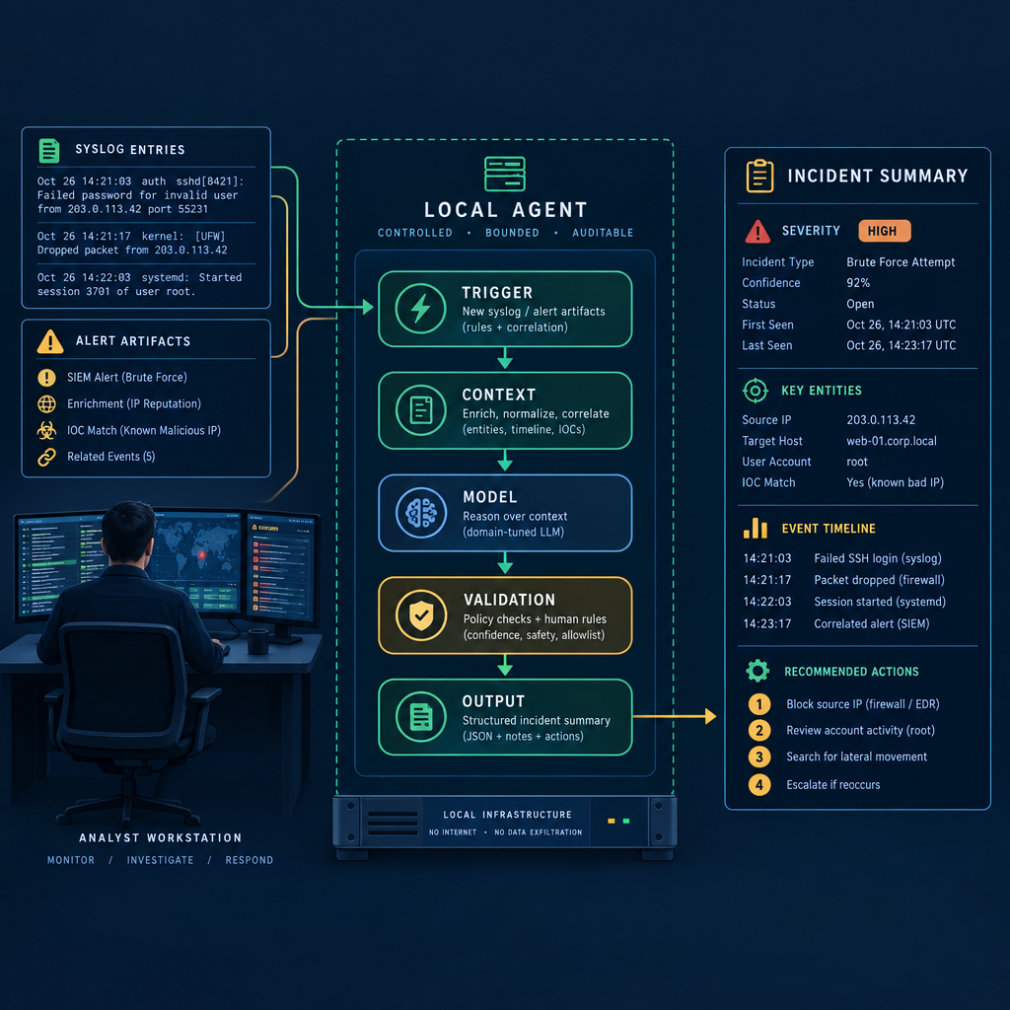
Why Agentic Workflows Matter to CPTs
SI-assisted operations
Evidence-first reasoning
Structured incident output
Human review points
Repeatable hunt triage
Notes:
Say:
"This course shifts from manual effects operations into SI-assisted workflow construction. We are not treating the model as an authority. We are building a local workflow that reads evidence, applies a prompt, produces structured output, and tells us when a human needs to review the result."
Show:
Place this lesson in the Block arc: students first build the agentic triage pattern, then reinforce it, then extend the pattern with retrieval, tools, and adversary-agent considerations in later activities.
Do:
Ask students to name one hunt task that is repetitive enough to automate but still risky enough to require human review. Capture two examples for reuse during the lecture.
Image Prompt:
Create a professional CPT operations graphic, 16:9. Show an analyst workstation receiving syslog entries and alert artifacts on the left, a bounded local agent workflow in the center with labeled nodes for trigger, context, model, validation, and output, and a structured incident summary on the right. Use dark blue, muted green, and amber accents. Make the agent look like controlled infrastructure, not a consumer chatbot or glowing humanoid robot.
Ask (Q):
What is the operational takeaway from this row?
Expected Response (A):
Facilitation. Restate the Say/Do in operator terms. Do not invent a new teaching point.

Slide 3
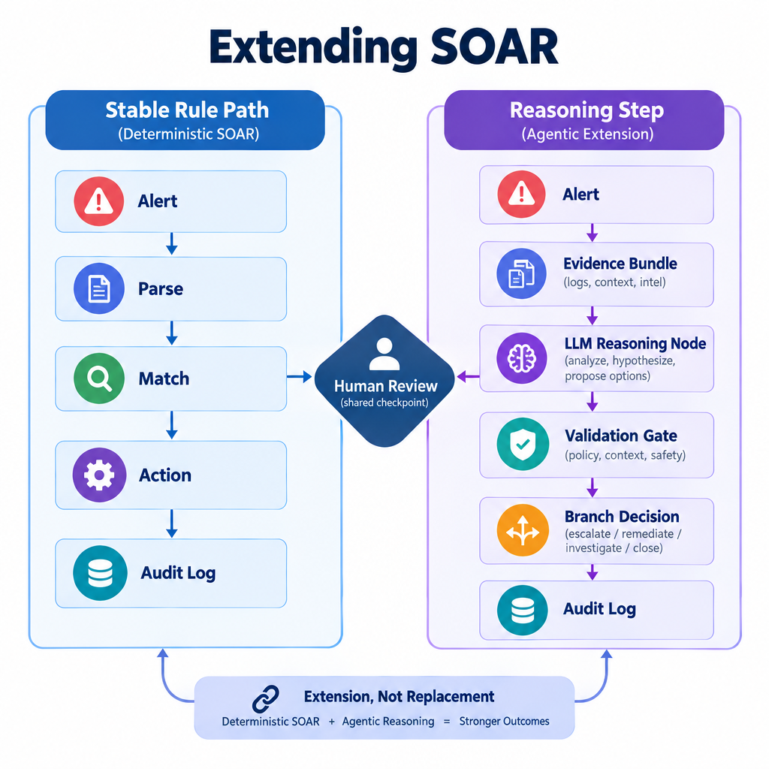
Extending SOAR with Agentic Workflows
Stable rules stay deterministic
Messy evidence needs reasoning
LLM as one workflow node
Validation before action
Operator judgment remains central
Notes:
Say:
"Do not hear this as 'SOAR is obsolete.' SOAR is excellent when the rule is clear and the data is stable. The agentic pattern belongs where the input is messy and the workflow needs a bounded reasoning step. The model does not replace orchestration; it becomes one controlled node inside it."
Show:
Walk the deterministic path first, then the reasoning path, and point out where validation gates prevent model output from becoming unchecked action.
Do:
Ask: "Which of these should stay deterministic: blocking a hash from a vetted feed, or summarizing an ambiguous process tree?" Have students explain the difference.
Image Prompt:
Create a clean technical comparison diagram, 16:9, titled "Extending SOAR." On the left, show a deterministic SOAR path labeled "Stable Rule Path": alert -> parse -> match -> action -> audit log. On the right, show an agentic extension path labeled "Reasoning Step": alert -> evidence bundle -> LLM reasoning node -> validation gate -> branch decision -> audit log. Use a shared human review checkpoint across both paths. Avoid implying replacement; show extension and integration.
Ask (Q):
Which of these should stay deterministic: blocking a hash from a vetted feed, or summarizing an ambiguous process tree?
Expected Response (A):
Facilitation. Use the Say/Do already on this row; do not force a single keyed answer.

Slide 4
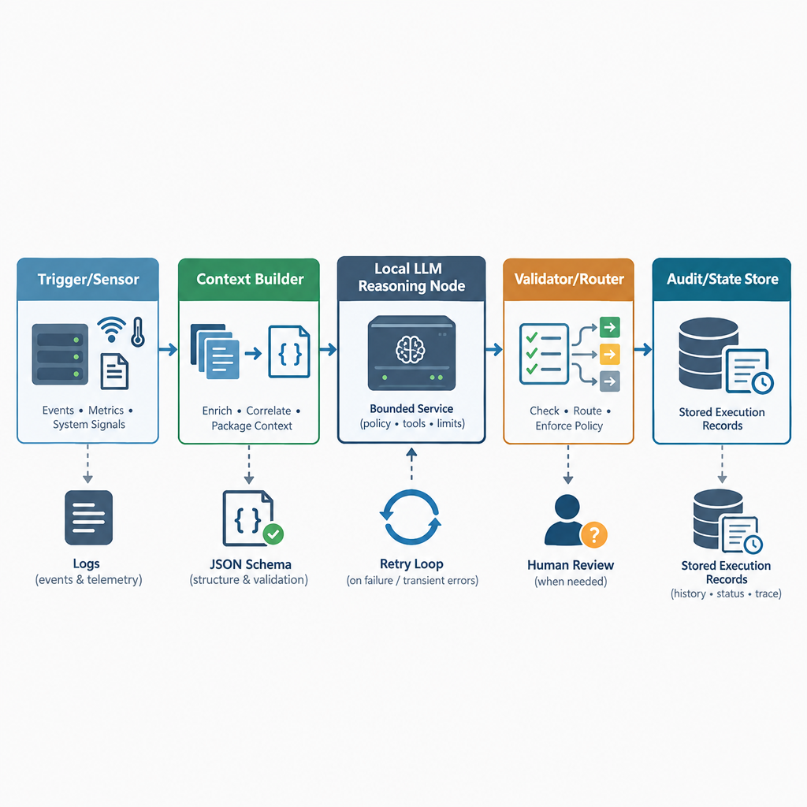
Anatomy of a Local SI Agent
Trigger or sensor
Context builder
Local reasoning node
Validator and router
State and audit trail
Notes:
Say:
"An agent is not just a model. The model is one reasoning node. The agent is the whole loop: what evidence enters, how context is built, what the model is allowed to produce, how the workflow validates it, and what record we keep afterward."
Show:
Highlight the validator/router block. Tie it directly to the reinforcement lab failure modes: malformed JSON, API failures, and disagreement between branches.
Do:
Have students repeat the operator test: "Can I explain what evidence went in, what prompt was used, what came out, and why the workflow took the branch it took?"
Image Prompt:
Create a left-to-right architecture diagram, 16:9, with five labeled blocks: Trigger/Sensor, Context Builder, Local LLM Reasoning Node, Validator/Router, and Audit/State Store. Add small, realistic icons for logs, JSON schema, retry loop, human review, and stored execution records. Use restrained tactical colors and clear arrows. Do not depict the LLM as autonomous, magical, or human-like; make it one bounded service node.
Ask (Q):
What is the operational takeaway from this row?
Expected Response (A):
Facilitation. Restate the Say/Do in operator terms. Do not invent a new teaching point.

Slide 5
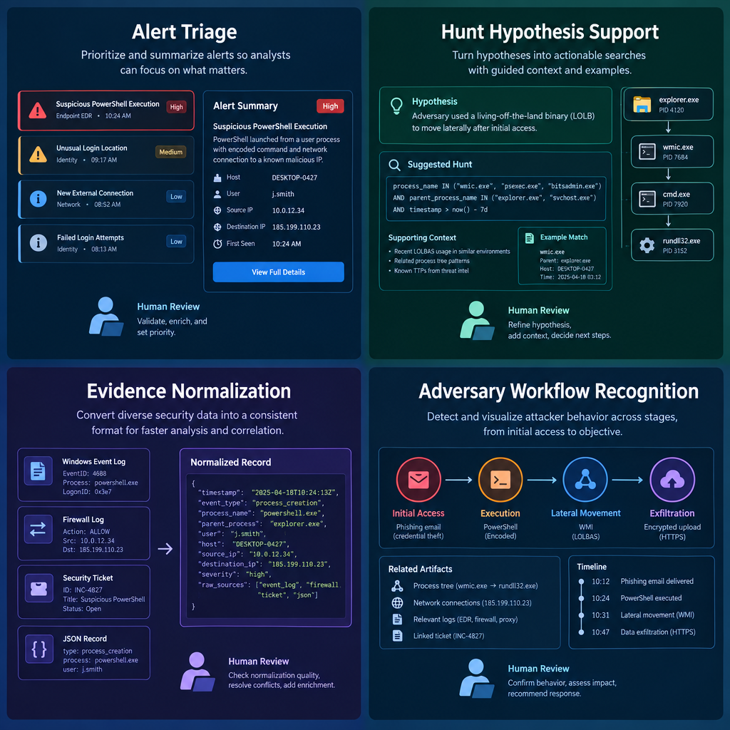
Operational Use Cases in CND and Hunt
Alert triage
Hunt hypothesis support
Evidence normalization
Confidence scoring
Adversary workflow recognition
Notes:
Say:
"The common thread is not chat. The common thread is evidence transformation. We are asking the workflow to take messy evidence, make a bounded assessment, produce a machine-readable artifact, and mark uncertainty. That is useful for defenders, and it is also exactly why adversaries will use the same pattern."
Show:
Connect each defensive example to a course build behavior: ingest, enrich, classify, validate, branch, and export.
Do:
Ask: "Where is the human review point in each use case?" If students skip it, bring them back to confidence and operational risk.
Image Prompt:
Create a four-panel operational use-case graphic, 16:9. Panels should show: alert triage, hunt hypothesis support, evidence normalization, and adversary workflow recognition. Use realistic security artifacts such as logs, tickets, process trees, and JSON records. Include a small human review icon in each panel. Avoid clutter, vendor logos, and cartoon robot imagery.
Ask (Q):
Where is the human review point in each use case?
Expected Response (A):
Facilitation. Use the Say/Do already on this row; do not force a single keyed answer.

Slide 6
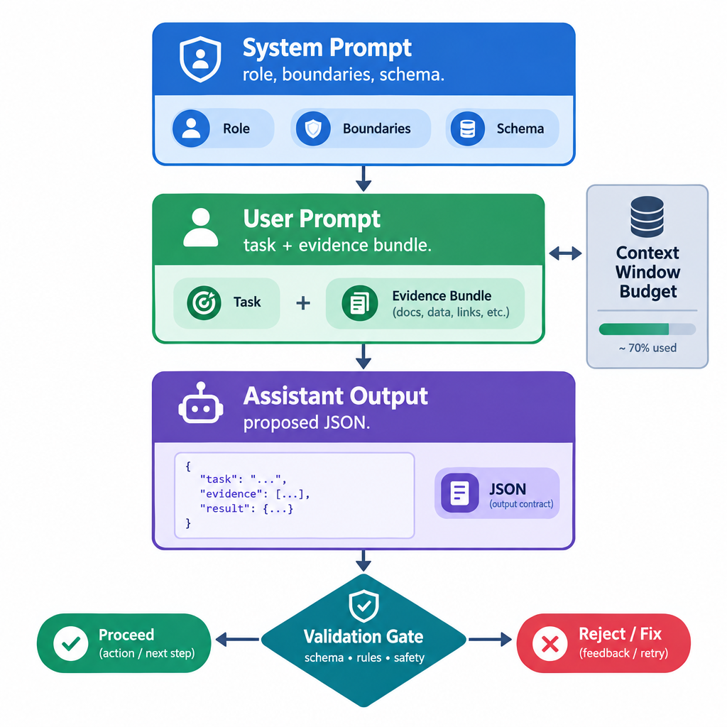
Prompt Structure: Instructions, Evidence, and Output Contract
System prompt
User prompt
Evidence bundle
Context window
Output contract
Notes:
Say:
"In a workflow, prompting is engineering. The system prompt defines stable behavior. The user prompt carries the current evidence. The output contract tells the model what shape downstream automation requires. If any one of those is vague, the workflow becomes brittle."
Show:
The three-layer prompt structure, then point to the validation gate after the assistant output.
Do:
Ask students what belongs in the system prompt versus the user prompt for a syslog triage workflow. Expected distinction: durable role/schema in system; current log and API results in user.
Image Prompt:
Create a layered prompt-engineering diagram, 16:9. Top layer: "System Prompt - role, boundaries, schema." Middle layer: "User Prompt - task + evidence bundle." Side box: "Context Window Budget." Bottom layer: "Assistant Output - proposed JSON." Place a validation gate after the output before any branch or action. Use clean labels, minimal text, and a visual hierarchy that makes the output contract obvious.
Ask (Q):
What is the operational takeaway from this row?
Expected Response (A):
Facilitation. Restate the Say/Do in operator terms. Do not invent a new teaching point.

Slide 7
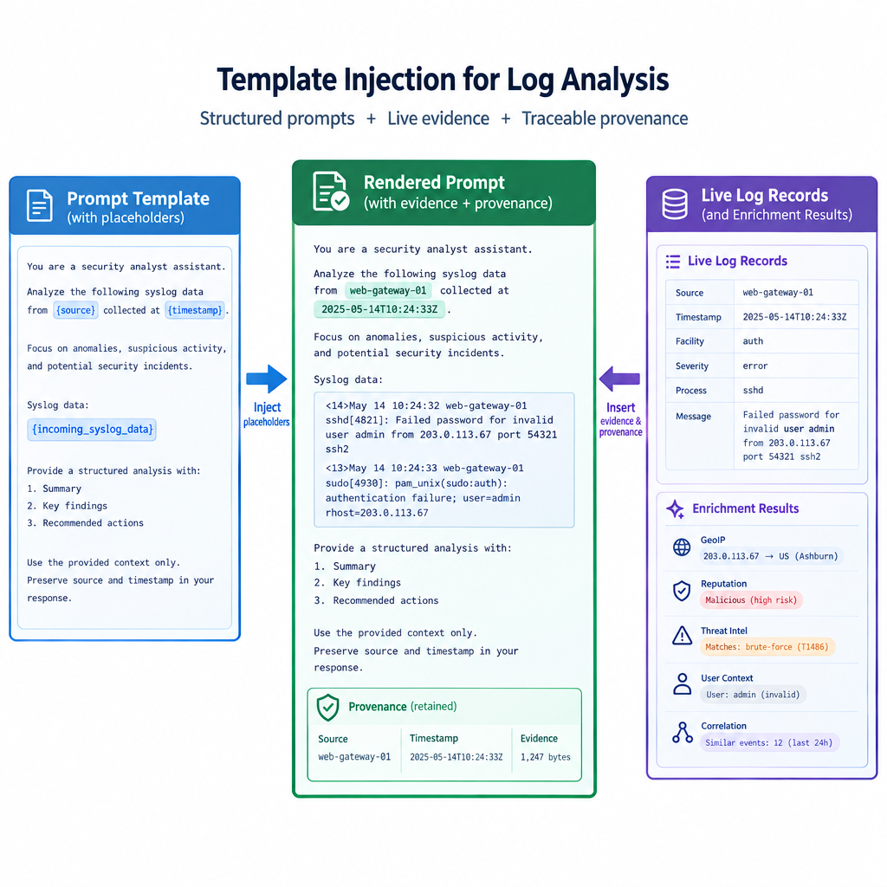
Prompt Templates Keep Logic Separate from Evidence
Static instructions
Dynamic variables
Evidence provenance
Repeatable criteria
Safer maintenance
Template example
Notes:
Say:
"We do not write a new prompt for every alert. We write a template. n8n injects the current log, source filename, timestamp, and enrichment results into known variables. That gives us repeatability and makes the output easier to debug."
Show:
The example `Analyze the following log for malicious activity: {{ incoming_syslog_data }}` and add a second notional variable such as `{{ threat_intel_result }}`.
Do:
Ask students which fields should be inserted automatically into every prompt for auditability: source artifact, timestamp, enrichment status, and workflow name.
Image Prompt:
Create a template-injection diagram, 16:9. On the left, show a prompt template document with labeled placeholders such as `{source}`, `{timestamp}`, and `{incoming_syslog_data}`. On the right, show live log records and enrichment results. In the center, show the rendered prompt with the evidence inserted and provenance retained. Use a precise engineering style, not a generic "code merging" illustration.
Ask (Q):
What is the operational takeaway from this row?
Expected Response (A):
Facilitation. Restate the Say/Do in operator terms. Do not invent a new teaching point.

Slide 8
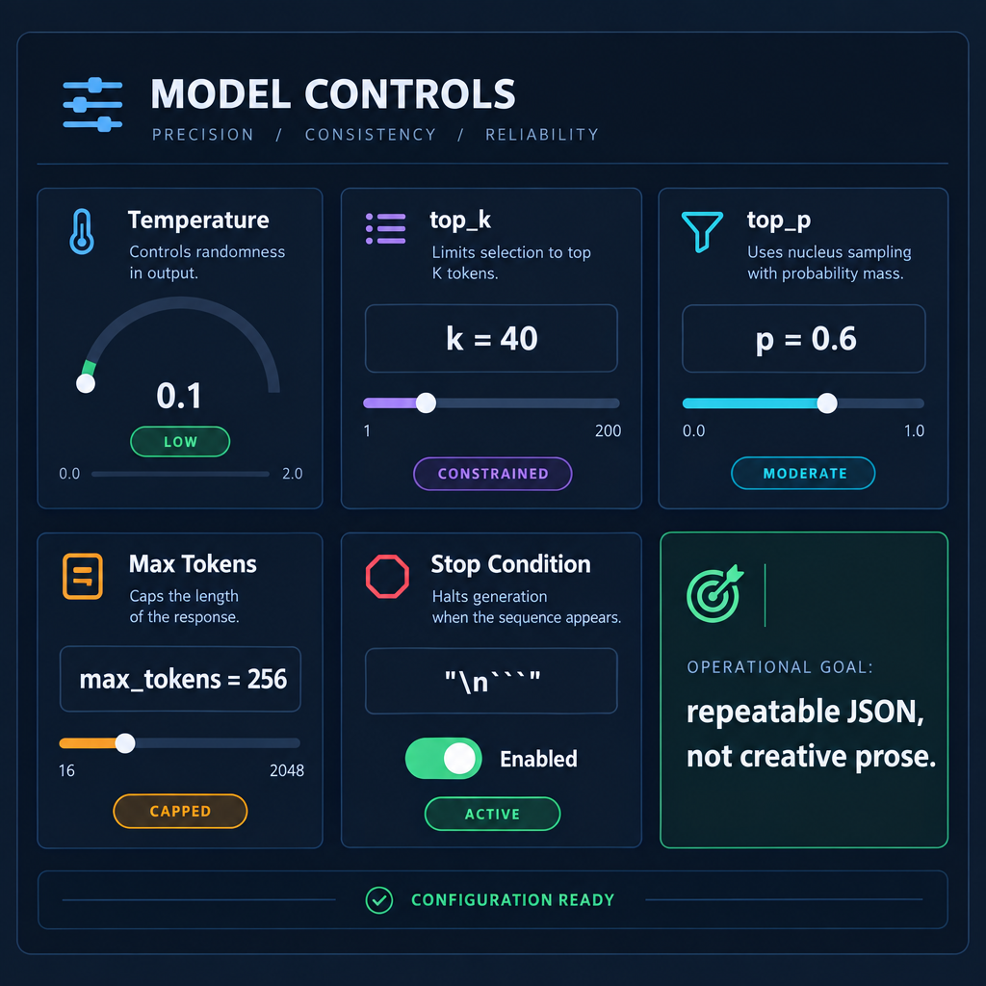
Controlling the Brain: Model Parameters
Low temperature
Constrained top_k
Moderate top_p
Capped max tokens
Stop conditions
Repeatable JSON
Notes:
Say:
"LLMs predict tokens. Parameters influence how much variation the model is allowed to introduce. For a poem, variation is useful. For an incident workflow, variation can break a parser or inflate confidence. Today we tune for boring, repeatable, short outputs."
Show:
The parameter controls and tie each to an operational failure mode: randomness, rambling, malformed output, or inconsistent confidence.
Do:
Ask students why a low-temperature model can still be wrong. Drive toward: deterministic does not mean accurate; it only means repeatable.
Image Prompt:
Create a dashboard-style graphic, 16:9, showing five model controls: Temperature set low, `top_k` constrained, `top_p` moderate, Max Tokens capped, and Stop Condition enabled. Add a side label: "Operational goal: repeatable JSON, not creative prose." Use instrument-panel styling with readable labels and no decorative robot imagery.
Ask (Q):
What is the operational takeaway from this row?
Expected Response (A):
Facilitation. Restate the Say/Do in operator terms. Do not invent a new teaching point.

Slide 9
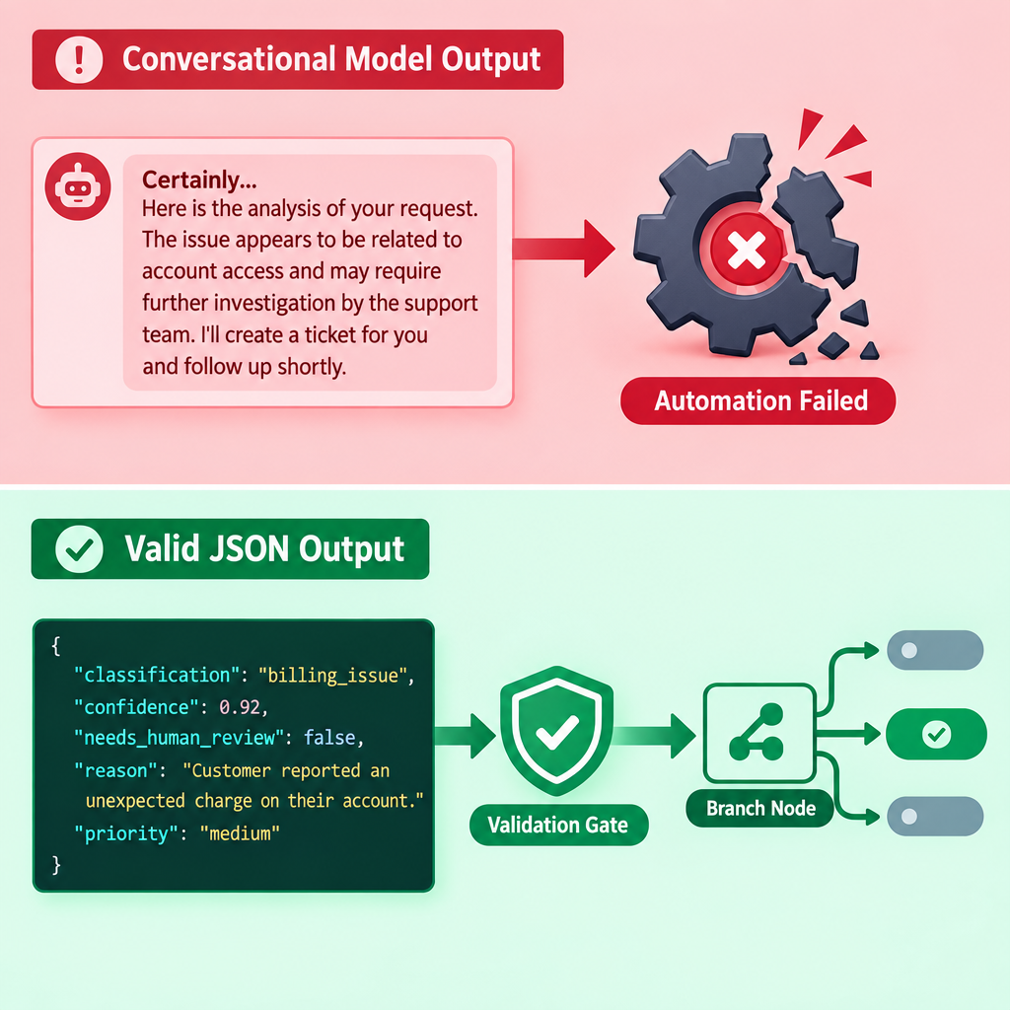
Enforcing Output Formats
Chat breaks automation
JSON enables routing
Schema defines fields
Format rules go up front
Validate before branching
Notes:
Say:
"Downstream nodes do not read intent; they read fields. If the model gives a paragraph when the next node expects `classification`, `confidence`, and `summary`, the workflow is broken. Structured output is what turns language into an operational artifact."
Show:
A small schema with `classification`, `confidence`, `summary`, `intel_unavailable`, and `needs_human_review`.
Do:
Warn that local models can still drift from the schema. Validate and retry; do not skip the parser.
Image Prompt:
Create a split-screen validation graphic, 16:9. Top half: red-tinted conversational model output beginning "Certainly..." hitting a broken automation gear. Bottom half: green-tinted valid JSON with fields such as `classification`, `confidence`, and `needs_human_review` passing through a validation gate into a branch node. Keep the JSON readable and the failure mode visually obvious.
Ask (Q):
What is the operational takeaway from this row?
Expected Response (A):
Facilitation. Restate the Say/Do in operator terms. Do not invent a new teaching point.

Slide 10
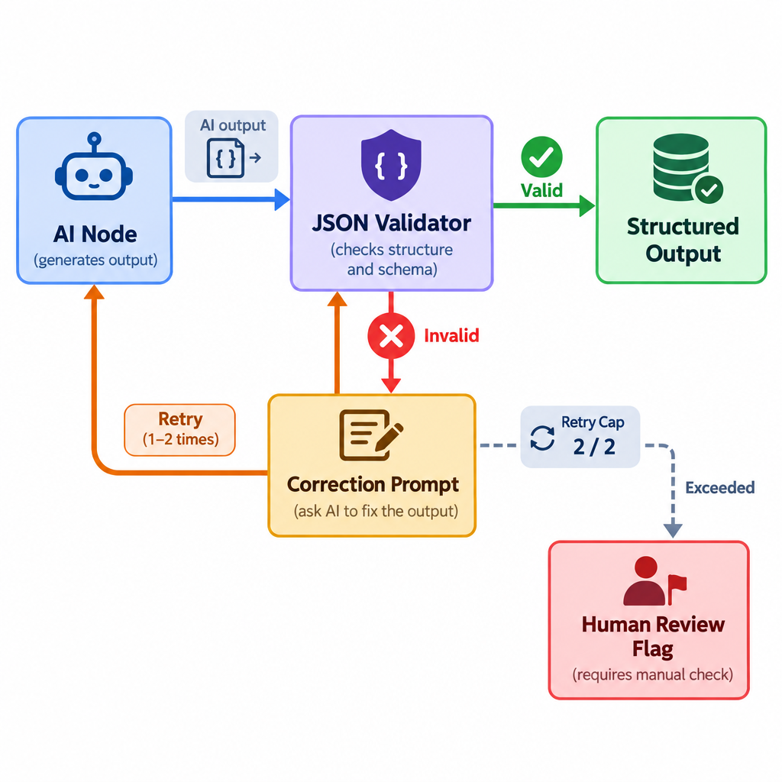
Handling Format Failures
JSON validation
Narrow correction prompt
Hard retry cap
Bounded reformat step
Visible review flag
Notes:
Say:
"Even with good prompts, models sometimes produce invalid format. The professional answer is not hope; it is validation. Try once or twice with a narrower correction prompt, then fail gracefully with a review flag. A workflow that fails visibly is safer than one that invents a clean-looking answer."
Show:
The validation loop and point at the retry cap.
Do:
Tell students the hands-on workflow will deliberately stress these failure modes: broken JSON, enrichment failure, and conflicting branch evidence.
Image Prompt:
Create a workflow failure-handling diagram, 16:9. Show output from an "SI Node" entering a "JSON Validator." The valid path uses a green check and proceeds to "Structured Output." The invalid path uses a red X, loops once or twice through "Correction Prompt," then exits to "Human Review Flag" after the retry cap. Include the retry cap as a visible counter, not an infinite loop.
Ask (Q):
What is the operational takeaway from this row?
Expected Response (A):
Facilitation. Restate the Say/Do in operator terms. Do not invent a new teaching point.

Slide 11
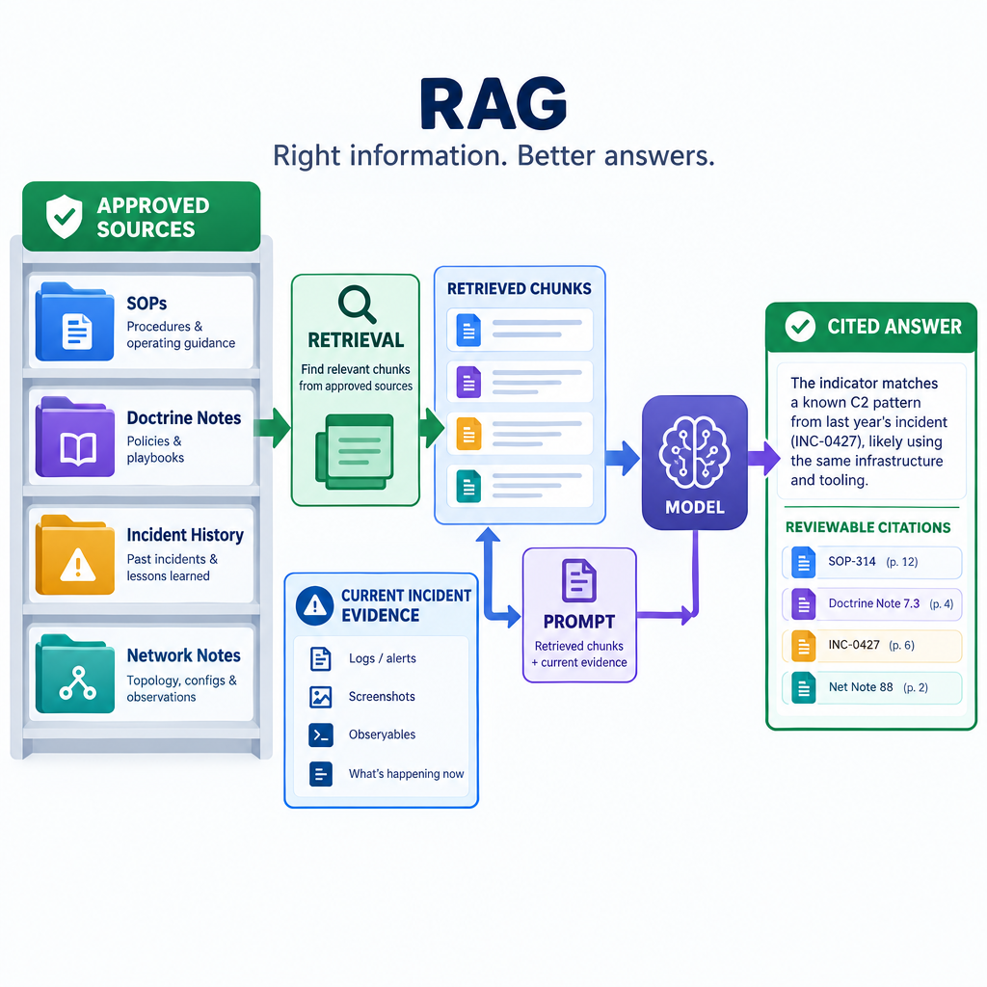
Intro to RAG: Evidence the Model Can Reference
Retrieval-Augmented Generation
Local source chunks
Current doctrine and SOPs
Prompt-time evidence injection
Reviewable citations
Notes:
Say:
"RAG is an open-book pattern. The model does not remember your local doctrine by default. The workflow searches the approved source material, retrieves the relevant chunks, and places those chunks into context. Now the model has evidence to reference."
Show:
Contrast model weights, which are static for our purposes, with retrieved context, which can be updated as documents change.
Do:
Keep this as a conceptual bridge. Students need the mental model here before the course turns retrieval into a primary build task.
Image Prompt:
Create a concise RAG concept graphic, 16:9. Show a controlled document shelf with SOPs, doctrine notes, incident history, and network notes feeding a retrieval step. Retrieved chunks enter the prompt beside current incident evidence, then flow into the model and out to a cited answer. Use labels that emphasize "approved sources" and "reviewable citations."
Ask (Q):
What is the operational takeaway from this row?
Expected Response (A):
Facilitation. Restate the Say/Do in operator terms. Do not invent a new teaching point.

Slide 12
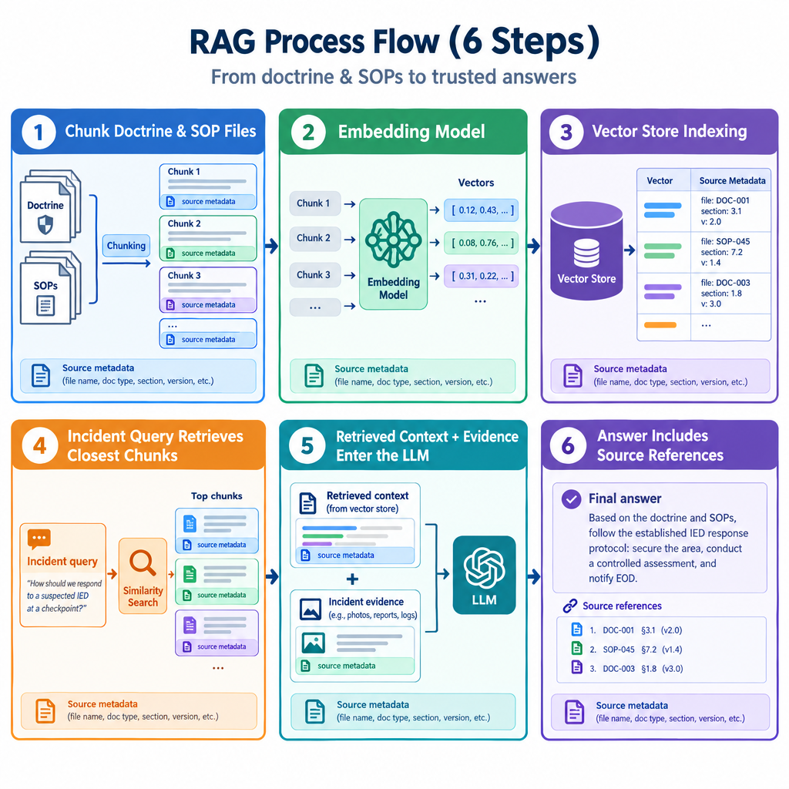
How RAG Works
Chunk source documents
Embed semantic meaning
Store vectors and metadata
Retrieve closest evidence
Inject and cite
Notes:
Say:
"The search is semantic. If an incident mentions suspicious PowerShell behavior, retrieval can find doctrine or notes that discuss command interpreters, script execution, or T1059-style behavior even when the exact words differ. That is why embeddings matter to hunt operations."
Show:
The full RAG flowchart, but keep the depth limited. Students only need the mental model today.
Do:
Ask students what can go wrong if the corpus contains stale or poisoned information. Save the answer for the later adversary-agent discussion.
Image Prompt:
Create a six-step RAG process flowchart, 16:9. Step 1: doctrine and SOP files are chunked. Step 2: an embedding model converts chunks into vectors. Step 3: a vector store indexes vectors with source metadata. Step 4: an incident query retrieves closest chunks. Step 5: retrieved context and incident evidence enter the LLM. Step 6: the answer includes source references. Use compact labels and make source metadata visible throughout.
Ask (Q):
What is the operational takeaway from this row?
Expected Response (A):
Facilitation. Restate the Say/Do in operator terms. Do not invent a new teaching point.

Slide 13
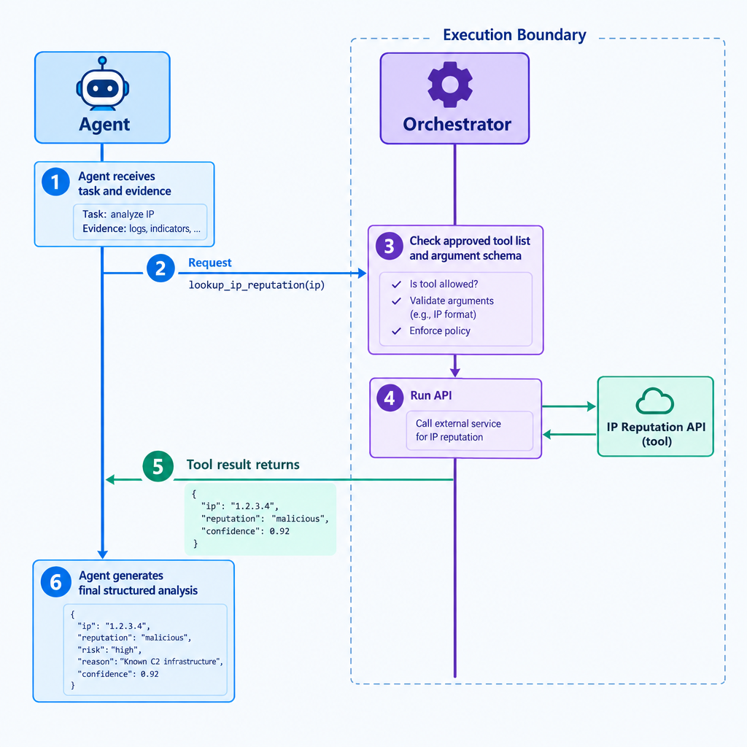
Tool Calling: Let the Workflow Act, Not the Model
Tool request, not execution
Approved tool list
Clear argument schema
Orchestrator control
Read-only enrichment first
Notes:
Say:
"Tool calling is how an agent gets new information or asks the workflow to do something. The model does not execute the tool. It emits a structured request. n8n checks the request, runs the approved tool, and returns the result."
Show:
The sequence diagram illustrating the pause in generation while the tool runs.
Do:
Emphasize that the current build uses simple enrichment and parsing patterns. Later course work expands this into controlled tool use with explicit audit expectations.
Image Prompt:
Create a sequence diagram, 16:9. Step 1: agent receives task and evidence. Step 2: agent requests `lookup_ip_reputation(ip)` from the orchestrator. Step 3: orchestrator checks the approved tool list and argument schema. Step 4: orchestrator runs the API. Step 5: tool result returns to the agent. Step 6: agent generates final structured analysis. Make the orchestrator the execution boundary.
Ask (Q):
What is the operational takeaway from this row?
Expected Response (A):
Facilitation. Restate the Say/Do in operator terms. Do not invent a new teaching point.

Slide 14
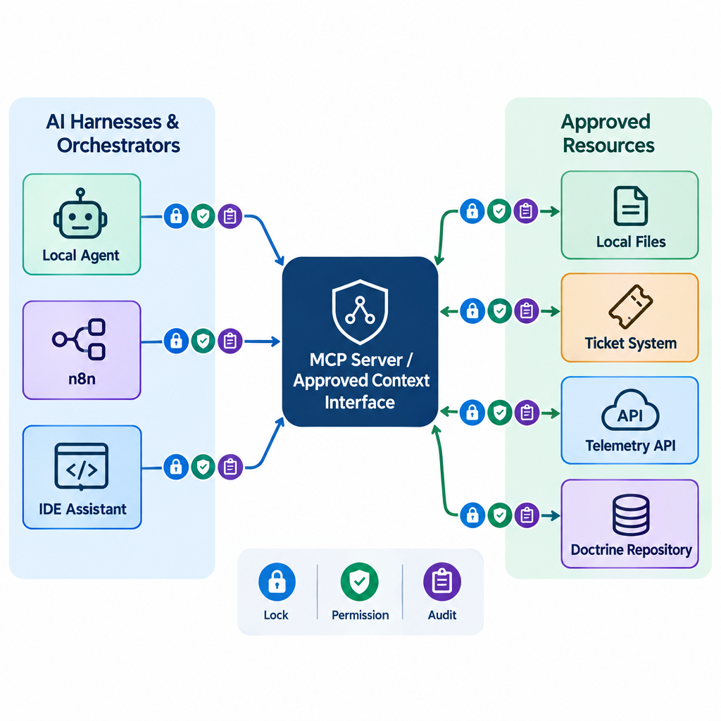
Standardizing Tools: Model Context Protocol (MCP)
Common tool interface
Approved context sources
Reusable integrations
Permission boundaries
Audit expectations
Notes:
Say:
"MCP is a standardization pattern. Instead of every agent building custom glue to every tool, an MCP server exposes approved capabilities in a common way. For an operational team, that matters because context access and tool access are part of the control surface."
Show:
The hub-and-spoke diagram and point out that the center is not just convenience; it is where access can be described and constrained.
Do:
Tell students they do not need to implement MCP today. They need to recognize why standards matter when agent workflows move from lab prototype to team service.
Image Prompt:
Create a hub-and-spoke architecture diagram, 16:9. Center node: "MCP Server / Approved Context Interface." Left side: SI harnesses and orchestrators such as local agent, n8n, and IDE assistant. Right side: approved resources such as local files, ticket system, telemetry API, and doctrine repository. Add lock, permission, and audit icons on each tool path. Keep the diagram vendor-neutral.
Ask (Q):
What is the operational takeaway from this row?
Expected Response (A):
Facilitation. Restate the Say/Do in operator terms. Do not invent a new teaching point.

Slide 15
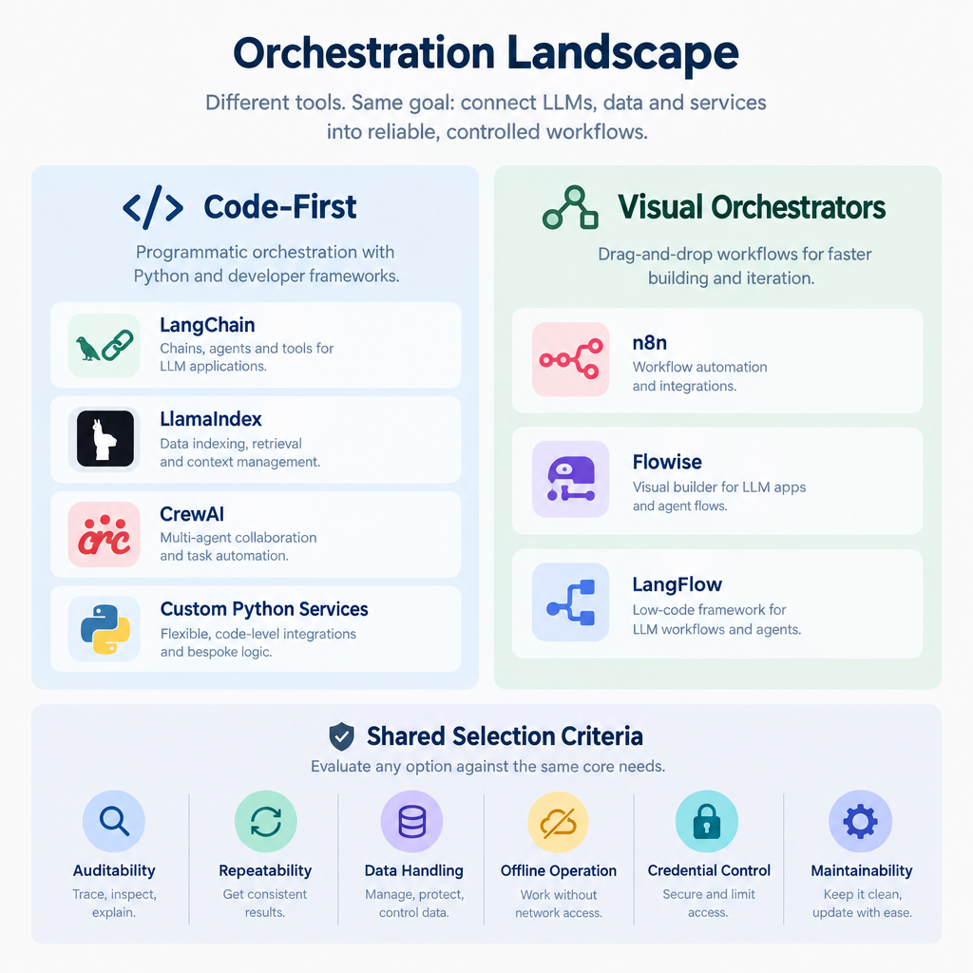
Surveying the Orchestration Landscape
Code-first frameworks
Visual orchestrators
Auditability
Offline operation
Credential control
Maintainability
Notes:
Say:
"The right tool depends on the mission and the team. A software team may want code-first control. A CPT classroom needs visibility, repeatability, and fast debugging. n8n gives us a graph that an instructor can grade and a student can explain."
Show:
A simple comparison: code-first for engineering depth; visual orchestration for workflow visibility and rapid operator iteration.
Do:
Ask students what they would need before approving either pattern in a real environment: logging, credential handling, review, backups, and failure behavior.
Image Prompt:
Create a neutral orchestration landscape graphic, 16:9. Show two columns: "Code-First" with LangChain, LlamaIndex, CrewAI, and custom Python services; and "Visual Orchestrators" with n8n, Flowise, and LangFlow. Below both columns, show shared selection criteria: auditability, repeatability, data handling, offline operation, credential control, and maintainability. Avoid making one option look universally superior.
Ask (Q):
What is the operational takeaway from this row?
Expected Response (A):
Facilitation. Restate the Say/Do in operator terms. Do not invent a new teaching point.

Slide 16
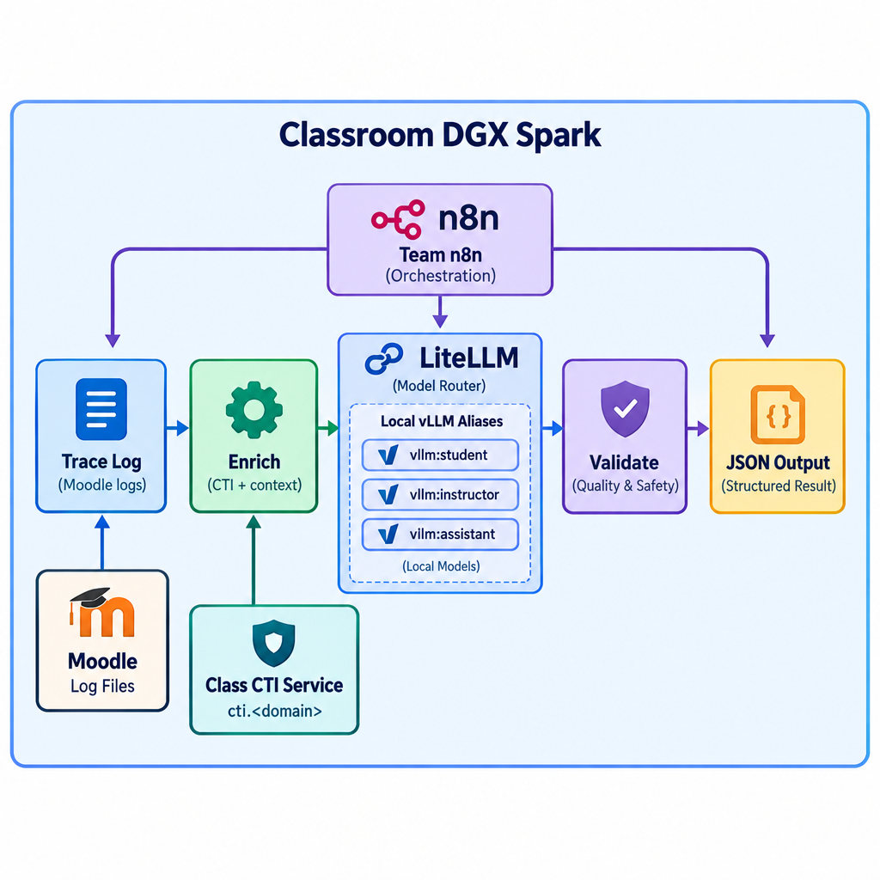
Classroom Stack
Team DGX Spark
n8n (enabled in this lab hour)
LiteLLM local aliases
Class CTI API
Moodle evidence
Visual debugging
Notes:
Say:
"Earlier stack setup left n8n out on purpose. This morning you add it to the team stack and create personal accounts. Inference goes through LiteLLM, never vLLM. CTI is a class service, not something you stand up per team."
Show:
Trace syslog from Moodle into n8n, CTI lookup, secondary then primary model, JSON out.
Do:
Have students name which component owns orchestration, inference, enrichment, and validation.
Image Prompt:
Create a classroom lab architecture diagram, 16:9. Show team n8n as orchestration, LiteLLM in front of local vLLM aliases, a class CTI service at cti.<domain>, Moodle log files, validation nodes, and JSON output. Boundary label: "Classroom DGX Spark." Trace log -> enrich -> local model -> validate -> output.
Ask (Q):
What is the operational takeaway from this row?
Expected Response (A):
Facilitation. Restate the Say/Do in operator terms. Do not invent a new teaching point.

Slide 17
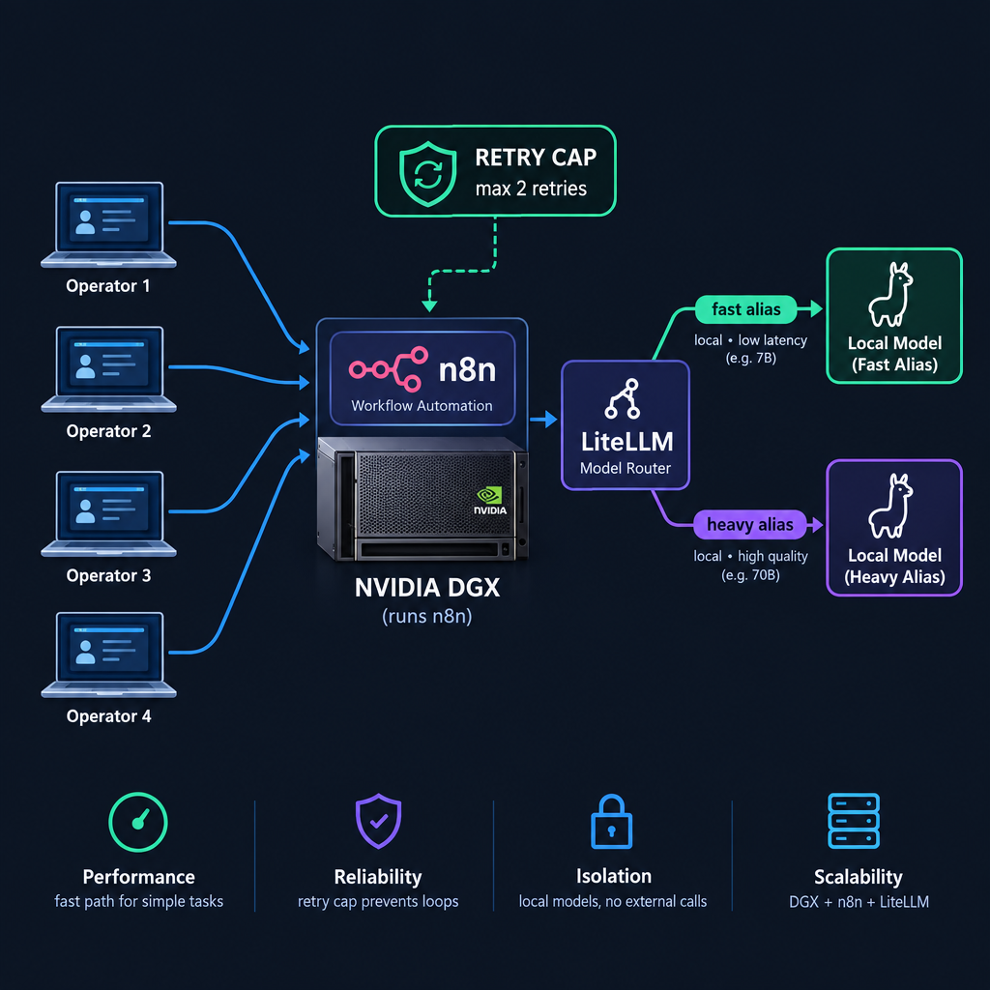
Shared GPU, Not a Tiny VM
Team-shared n8n
GPU local models
LiteLLM aliases
Queueing and timeouts
Personal workflow names
Bounded retries
Notes:
Say:
"You are not on a 16 GB CPU VM. You are on a shared Spark. GPU is faster, but concurrent class use still needs timeouts, retries, and the lighter alias for bulk extract. Name workflows with your last name so grading does not collide."
Show:
Secondary alias for IP extract, primary for triage, retry cap from the afternoon lab.
Do:
Ask what fails first if every team hits the heavy alias at once.
Image Prompt:
Create a technical constraints graphic, 16:9. Show several operator laptops pointing at one n8n on a DGX, LiteLLM routing to a fast local alias and a heavy local alias, plus a retry-cap badge. Keep it technical.
Ask (Q):
What is the operational takeaway from this row?
Expected Response (A):
Facilitation. Restate the Say/Do in operator terms. Do not invent a new teaching point.

Slide 18
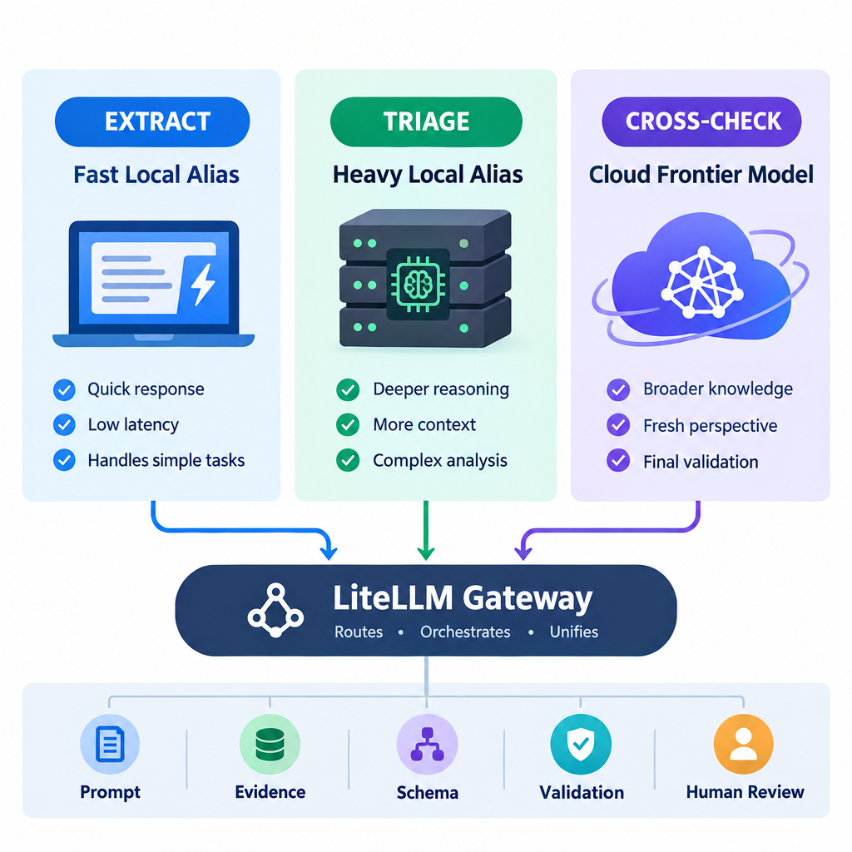
Local Models and the Cloud Frontier
Local secondary: extract
Local primary: triage
Cloud frontier: cross-check
Same LiteLLM gateway
Same schema and validation
Classroom only
Notes:
Say:
"Morning uses two local models through LiteLLM. Afternoon adds a cloud frontier model on the second branch. The gateway is the same; the trust boundary is not. Keep the schema, validation, and human-review flag when the model changes."
Show:
Extract vs triage vs frontier-branch reinforcement. CTI summaries also use a local alias on the instructor host — students only see the API.
Do:
Ask what must stay unchanged when the model changes. Expected: evidence boundaries, prompt structure, output schema, validation, audit, human review.
Image Prompt:
Create a three-stage model graphic, 16:9. Left: fast local alias labeled extract. Center: heavy local alias labeled triage. Right: cloud frontier model labeled cross-check. All three sit behind one LiteLLM gateway. Shared footer: prompt, evidence, schema, validation, human review. No vendor logos.
Ask (Q):
What is the operational takeaway from this row?
What is the operational takeaway from this row?
Which of these should stay deterministic: blocking a hash from a vetted feed, or summarizing an ambiguous process tree?
What is the operational takeaway from this row?
Expected Response (A):
Facilitation. Restate the Say/Do in operator terms. Do not invent a new teaching point.
## Lesson summary
B04.M12-build-agentic-workflow is executed as a generated lesson plan from this file.
Assessment methods live on module.yaml; do not invent extra official ELOs.
Later practice in this Block continues from the product this session collects.
## Questions and check on learning
Facilitation. Restate the Say/Do in operator terms. Do not invent a new teaching point.
Facilitation. Use the Say/Do already on this row; do not force a single keyed answer.
Facilitation. Restate the Say/Do in operator terms. Do not invent a new teaching point.

Slide 19
Questions?

